Slide 1
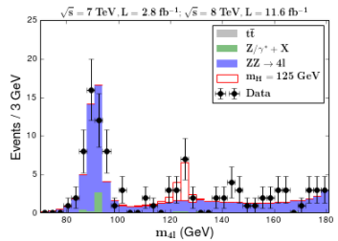
CMS masterclass update
New developments planned for IMC 2019
Move Higgs events out of WZH → WZ measurement
New measurement
Use ~10² events with 4 leptons
Make mass plot <90 GeV to >180 GeV
Supplement to WZ?
Use Jupyter notebook?
Old measurement
Mostly stable
Still need to add D-Y

